Slide 1
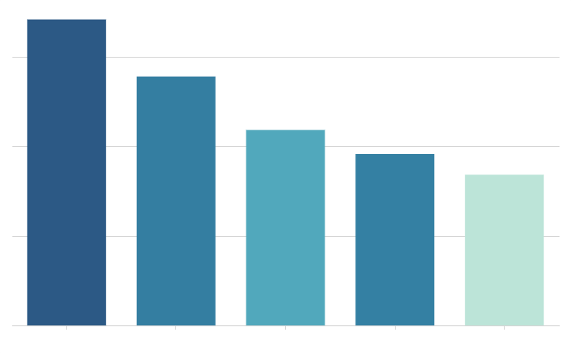
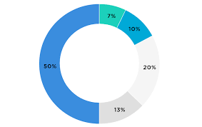
World Air Quality
Country and AQI Filter
AQI Values per Country
AQI Values per Cities
Map Showing Different Air Quality Ratings across the world
Color Scale (Green areas have better ratings, yellow are moderate and red are bad)

